Slide 1
User-Oriented Solving and Explaining
of Natural Language Logic Grid Puzzles
Jens Claes¹, Bart Bogaerts², Rocsildes Canoy², Tias Guns²
¹jensclaes33@gmail.com
²Vrije Universiteit Brussel, firstname.lastname@vub.be

Slide 2
Holy Grail-ish
From human-level problem specification, to human-level solving and explanation.
applied on
Logic Grid Puzzles¹
How ?
Clues in
Natural Language
Visual explanation
of reasoning steps
Logic Grid
¹https://freuder.wordpress.com/pthg-19-the-third-workshop-on-progress-towards-the-holy-grail/

Slide 3
Zebra Tutor, a Holy Grail
“From human-level problem specification to human-level solving and explanation.”
Our design choices:
Input: natural language (with semi-automated processing)
Reasoning: Blackburn & Bos semantic parsing + IDP solver
Output: visual explanation
Abstractions: grid visualisation and clues
Ordering of reasoning steps: by 'mental effort',
in practice: order by number of clues used, then by number of facts used

Slide 4

HolyZebra approach
Pos
Tagging
Chunking &
Lexicon building
First order
Logic
IDP
Language
Explanation
Generation
Clues
Visualisation
.json
.py
.py
.idp
.json
.pl
Notes:
some diagram of the different steps, as described in the paper (A-F)

Slide 5
POS tagging
Clues
Pos
Tagging
Chunking &
Lexicon
First-Order
Logic
IDP
Language
Explanation
Generation
Visualisation
In: Natural Language sentences
Out: Part-Of-Speech tagged words
Technically: NLTK's Perceptron tagger with the Penn Treebank POS set
VBD
RB
"The patient who was prescribed Enalapril is not Heather”¹
DT
NN
WP
VBN
NN
VBZ
NNPN
¹Output : (the, DT), (patient, NN), (who, WP), (was, VBD), (prescribed, VBN), (enalapril, NN), (is, VBZ), (not, RB), (heather, NNPN).

Slide 6
B) Chunking and lexicon building
In: POS tagged sentences (the, DT), (patient, NN), (who, WP), (was, VBD), (prescribed, VBN), (enalapril, NN), (is, VBZ), (not, RB), (heather, NNPN)
Mid: Chunking
(the, det), (patient, noun), (who, relpro), ((was, prescribed), tvGap), (enalapril, pn), ((is, not), cop), (heather, pn)
Out: Lexicon for our B&B grammar (next slide)
… noun([patient], [patients]), pn([heather]), pn([enalapril]), tvGap([was, prescribed], [for, their, heart, condition], [prescribe]), …
Old school NLP approach: regular expressions, semi-automated
Difficulty: custom vocabulary per puzzle, word-play by authors

Slide 7
Chunking and lexicon building
Clues
Pos
Tagging
Chunking &
Lexicon Building
First-Order
Logic
IDP
Language
Explanation
Generation
Visualisation
In: POS tagged sentences
(the, DT), (patient, NN), (who, WP), (was, VBD), (prescribed, VBN), (enalapril, NN), (is, VBZ), (not, RB), (heather, NNPN)
Mid: Chunking
(the, det), (patient, noun), (who, relpro), ((was, prescribed), tvGap), (enalapril, pn), ((is, not), cop), (heather, pn)
Out: Lexicon for our B&B grammar
… noun([patient], [patients]), pn([heather]), pn([enalapril]), tvGap([was, prescribed], [for, their, heart, condition], [prescribe]), …

Slide 8
Chunking and lexicon building
Clues
Pos
Tagging
Chunking &
Lexicon Building
First-Order
Logic
IDP
Language
Explanation
Generation
Visualisation
In: POS tagged sentences
Mid: Chunking
Out: Lexicon for our B&B grammar (next slide)
Old school NLP approach:
regular expressions
semi-automated
Difficulty:
custom vocabulary per puzzle
word-play by authors

Slide 9
To logic
Clues
Pos
Tagging
Chunking &
Lexicon Building
First-Order
Logic
IDP
Language
Explanation
Generation
Visualisation
Input: Lexicon and Grammar
Output: Discourse Representation Theory
Blackburn and Bos framework as a base:
Defined grammar based on 10 other puzzles, which includes :
Template sentences specific to logic grid puzzles
alldifferent rules : “John, Mary and Jack are three different persons”
Numerical comparisons (“John scored 3 points higher than Mary”), …
Extended framework to reason about types:
Identification of badly typed, but grammatically correct sentences.
Example: “The grass is drinking the house.”

Slide 10
To IDP language
Clues
Pos
Tagging
Chunking &
Lexicon Building
First-Order
Logic
IDP
Language
Explanation
Generation
Visualisation
Input: Logical Representation (Discourse Representation Theory)
Output: IDP Puzzle specification
Compute interpretation of different types
Type deduction from grid (if available)
Type inference from sentence(s).
“The Englishman smokes cigarettes”
“The person who owns a dog does not smoke cigars”

Slide 11
To IDP language
Clues
Pos
Tagging
Chunking &
Lexicon Building
First-Order
Logic
IDP
Language
Explanation
Generation
Visualisation
Input: Logical Representation (Discourse Representation Theory)
Output: IDP Puzzle specification
Compute interpretation of different types
Type deduction from grid (if available)
Type inference from sentence(s).
also supports missing entities (e.g. the zebra)

Slide 12
To IDP language
Clues
Pos
Tagging
Chunking &
Lexicon Building
First-Order
Logic
IDP
Language
Explanation
Generation
Visualisation
Input: Logical Representation (Discourse Representation Theory)
Output: IDP Puzzle specification
Compute interpretation of different types
Build Vocabulary
Types and relation for each transitive verb or preposition
Ensure at least 1 relation between each 2 types
Important for explanation
“John lives in the red house”
LivesIn(<person>, <house>)

Slide 13
To IDP language
Clues
Pos
Tagging
Chunking &
Lexicon Building
First-Order
Logic
IDP
Language
Explanation
Generation
Visualisation
Input: Logical Representation (Discourse Representation Theory)
Output: IDP Puzzle specification
Compute interpretation of different types
Build Vocabulary
Construct IDP Theories:
1. Translate each clue into IDP language
2. Add implicit constraints present in logic grid puzzles :
- Synonymy
- Bijection (lives_in / owns_house)
- Transitivity (rel1(A,B) rel2(B,C) → rel3(A,C))

Slide 14
To IDP language
Clues
Pos
Tagging
Chunking &
Lexicon Building
First-Order
Logic
IDP
Language
Explanation
Generation
Visualisation
Input: Logical Representation (Discourse Representation Theory)
Output: IDP Puzzle specification
Compute interpretation of different types
Build Vocabulary
Construct IDP Theories:
Solving the Puzzle using the IDP solver (ASP / model expansion / lazy clause generation – like solver)

Slide 15
To explanations
Clues
Pos
Tagging
Chunking &
Lexicon Building
First-Order
Logic
IDP
Language
Explanation
Generation
Visualisation
ordering of reasoning steps by mental effort required
get_reasoning_step(S: current partial assignment):
Until a solve leads to propagation (a more strict partial assignment):
Try: solve S + all implicit constraints
For n=0..|clues|, for all subsets of clues of size n: Try: solve S + the constraints from the subset of clues Break if it lead to propagation
For each literal that was assigned during propagation:
Compute minimal partial assignment S' needed to derive the literal
→ the S' is the UNSAT core when negating the literal
Store (S', clues used, literal)
return (S', clues, literal) with smallest S'

Slide 16
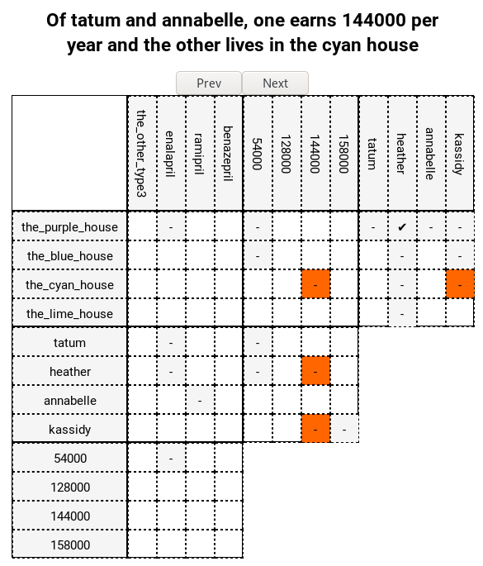
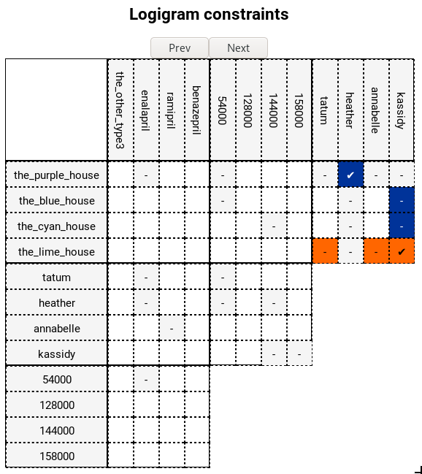
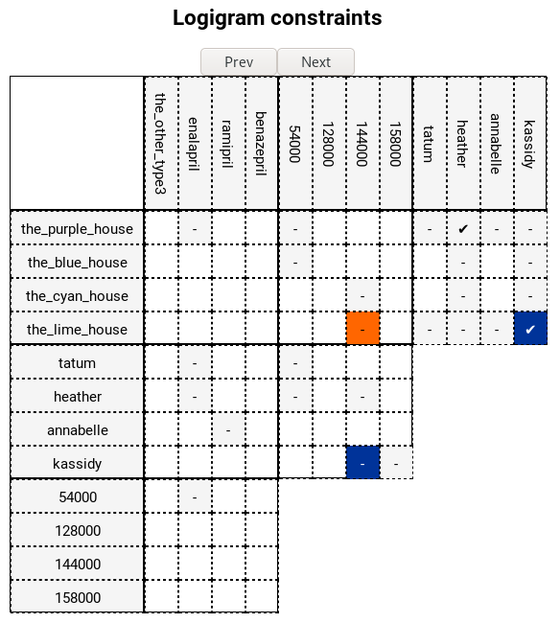
Visualisation¹
Clues
Pos
Tagging
Chunking &
Lexicon Building
First-Order
Logic
IDP
Language
Explanation
Generation
Visualisation
¹ https://bartbog.github.io/zebra/

Slide 17
Related work
Solving Logic Puzzles : From Robust Processing to Precise semantics
Iddo Lev¹, Bill MacCartney¹, Christopher D. Maning², and Roger Levy²
¹Department of Computer Science, Standford University {iddolev|wcmac|manning}@cs.standford.edu
²Department of Linguistics, Stanford University rog@standford.edu
Similarities
Solver : FOL reasoner
Semantic Logic language
Compositional semantics : Blackburn&Bos
Differences
Data : GRE¹ and LSAT² multiple-choice logic puzzles with 1 correct answer:
Backtracking ambiguities : ranking of possible output representations
Statistical parser
Generic semantic rules applicable to other problem settings
¹Graduate Record Exam, ²Law School Admission Test

Slide 18
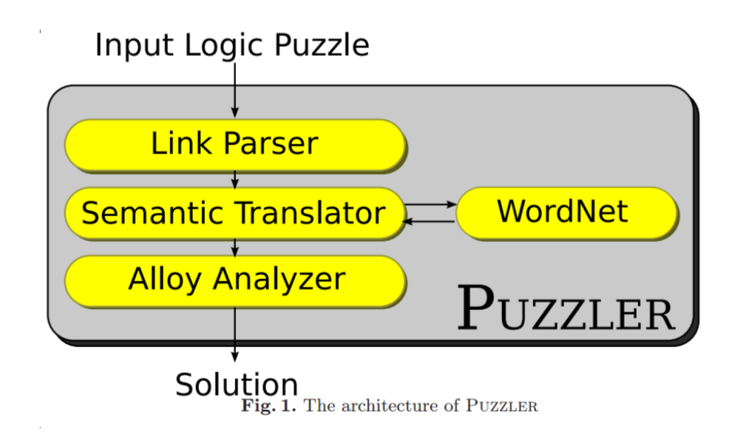
Related work
LogicSolver – Solving Logic Grid Puzzles with POS Tagging and First-Order Logic.
Ross Nordstram
University of Colorado rnordstr@uccs.edu
Similarities
Solve Logic Grid Puzzles
Parsing steps:
Pre-processing ( ~ .json)
POS tagging
Parse statements into FOPL Language model
Named-Entity Recognition (NER) = help identify comparisons or quantifiers
POS tag pattern matching
Solve using FOPL with built-in puzzle semantics
Differences
Goal : POS Tagging, First-order Logic
Puzzler (reasoner) as a base system.
Link Grammar Parser
Notes:
While our Goal is an end-to-end solution, emphasis on explanation

Slide 19
Conclusion
From human-level problem specification to human-level solving explanation.
Our design choices:
input: natural language, semi-automated processing
reasoning: Blackburn & Bos semantic parsing + IDP solver
output: visual explanation
abstractions: grid visu and clues
ordering: by mental effort, proxy = nr of literals used
Can also serve as 'help' function when user is stuck

Slide 20
Conclusion and future work
From human-level problem specification to human-level solving explanation.
Our design choices:
input: natural language, semi-automated processing
reasoning: Blackburn & Bos semantic parsing + IDP solver
output: visual explanation
abstractions: grid visu and clues
ordering: by mental effort, proxy = nr of literals used
Can also serve as 'help' function when user is stuck
Better NLP: statistical techniques?
Explanation orderings and proxies for 'mental effort'
Explanation abstractions, e.g. important parts of clue
Other puzzle explanations
Applicability in industrial problems, e.g. scheduling?

